Slide 1

Data 603 – Big Data Platforms
Lecture 8
Structured Streaming (Part 2)

Slide 2
Streaming Data Sources and Sinks
DataFrames from streaming sources can be created using SparkSession.readStream() method
DataFrames output using DataFrame.writeStream()
Source type is specified using format() method.

Slide 3
Data Sources - Files
Structured Streaming supports reading and writing data to and from files
When reading from files:
All the files must be of the same format and are expected to have the same schema.
Each file must appear in the directory listing automatically
Whole file must be available at once.
Any changes to the file will not be processed
Within micro-batch, there is no predefined order of reading of files. All of them are read in parallel
Only some of the new files will be picked up during the next micro-batch

Slide 4
Data Sources - Files
Writing to files
Only append mode is supported.
End-to-end exactly-once guarantees when writing to files by maintaining a log of the data files that have been written to the directory.
The log is maintained in _spark_metadata sub-directory.
Spark query on the directory will automatically use the log to read the correct set of data files to maintain exactly-one guarantee
Any schema change after the restart will create data in multiple schemas
These schemas will need to be reconciled when querying the directory

Slide 5
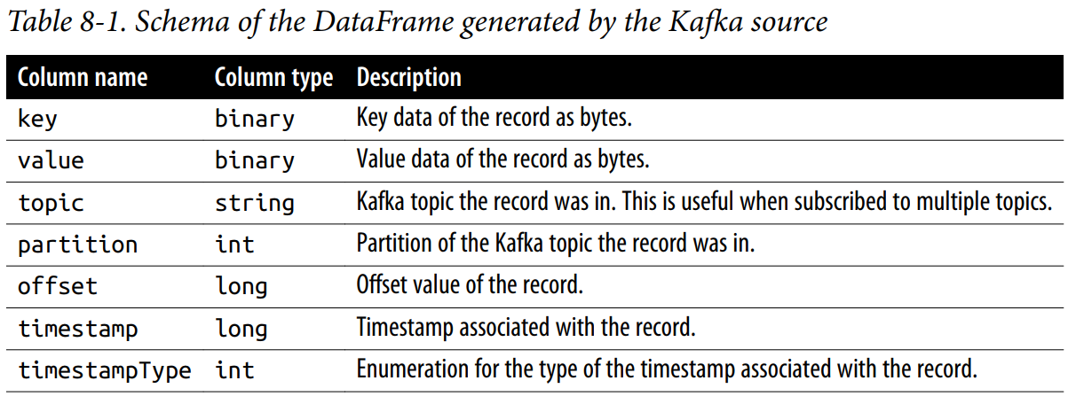
Data Sources – Apache Kafka
Popular sub/pub system
Used for storage of data streams
Structured Streaming has built-in support for reading from and writing to Apache Kafka
inputDF = (spark.readStream.format("kafka")
.option("kafka.bootstrap.servers", "host1:port1,host2:port2")
.option("subscribe", "events")
.load())

Slide 6
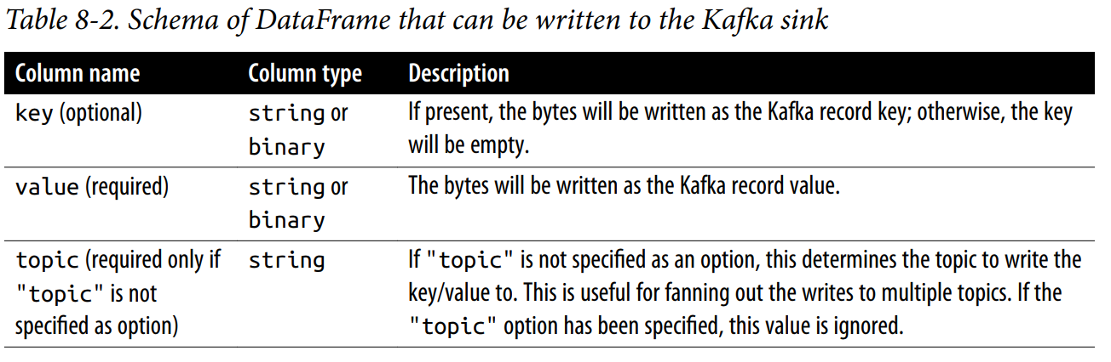
Data Sources – Apache Kafka
Writing to Kafka
Structured Streaming expects the result DataFrame to have a few columns of specified names and types
Can write to Kafka in all three modes.
Complete mode is not recommended

Slide 7
Data Sources – Apache Kafka
Writing to Kafka Examples
counts = ... # DataFrame[word: string, count: long]
streamingQuery = (counts
.selectExpr(
"cast(word as string) as key",
"cast(count as string) as value")
.writeStream
.format("kafka")
.option("kafka.bootstrap.servers", "host1:port1,host2:port2")
.option("topic", "wordCounts")
.outputMode("update")
.option("checkpointLocation", checkpointDir)
.start())

Slide 8
Data Transformations
Only the DataFrame operations that can be executed incrementally are supported in Structured Streaming
Catalyst optimizer in Spark SQL converts all the DataFrame operations to an optimized logical plan
SQL Planner generates a continuous sequence of execution plans (vs. converting the logical plan to a one-time physical execution plan)
The plan processes only a chunk of new data from the input streams and possible some intermediate, partial result computed by the previous execution plan.
Each execution is considered as a micro-batch
The partial intermediate result that is communicated between the executions is called the streaming “state”.

Slide 9
Stateless Transformations
An operation that process each input record individually without needing any information from previous rows
All project operations (e.g. select(), explode(), map(), flatMap()) and selection operations (e.g. filter(), where())
Streaming query with only stateless operations support the append and update output modes (no complete mode).
Any processed output row of such a query cannot be modified by future data.
These queries do not combine information across input records.

Slide 10
Stateful Transformations
Simplest form: DataFrame.groupBy().count()
Generating a running count of the number of records received since the beginning of the query.
State:
In micro-batch, the incremental plan adds the count of new records to the previous count generated by the previous micro-batch
This partial count communicated between plans is the state.
The state is maintained in the memory of the Spark executors.
The state is checkpointed to the configured location in order to tolerate failures.

Slide 11
Fault-tolerant State Management
Spark’s scheduler (running in the driver) breaks down high-level operations into smaller tasks.
Each task is put into a queue.
When resources are available, the executors pull the tasks from the queue to execute them.
Each micro-batch in a streaming query performs such set of tasks:
Read data from streaming sources and write updated output to streaming sinks
Intermediate state data are generated by the micro-batch of tasks
The intermediate state data are consumed by the next micro-batch
State data generation is partitioned and distributed.
It is cached in the executor memory for efficient consumption

Slide 12
Types of Stateful Operations
Two types of stateful operations
Managed stateful operations
Automatically identify and clean up old state based on an operation specific definition of “old” (can be defined).
Streaming aggregations
Stream-stream joins
Streaming deduplication
Unmanaged stateful operations
Users define their own custom state clean up logic
MapGroupsWithState
FlatMapGroupsWithState

Slide 13
Stateful Streaming Aggregations
Aggregations not based on time
Global aggregations
Aggregations across all the data in the stream. E.g. calculating the running count of the total number of readings received from a sensor.
runningCount = sensorReadings.groupBy().count()
NOTE: For streaming DataFrames, you always need to use DataFrame.groupBy() or Dataset.groupByKey() for aggregations. Direct aggregation operations like DataFrame.count() and Dataset.reduce() cannot be used.
Grouped aggregations
Aggregation within each group or key present in the data stream. E.g. Aggregating data coming from multiple sensors – calculating the running average reading of each sensor.
baselineValues = sensorReadings.groupBy("sensorId").mean("value")

Slide 14
Streaming DataFrame supported aggregations
All built-in aggregation functions
sum(), mean(), stddev(), countDistinct(), collect_set(), approx_count_distinct(), etc.
Multiple aggregations computed together
from pyspark.sql.functions import *
multipleAggs = (sensorReadings.groupBy("sensorId").agg(count("*"),mean("value").alias("baselineValue"),
collect_set("errorCode").alias("allErrorCodes")))
User-defined Aggregation Functions
All user-defined aggregation functions are supported.

Slide 15
Stateful Streaming Aggregations
Aggregations based on time – aggregation over data bucketed by time windows.
In a grouped aggregation, aggregate values (e.g. counts) are maintained for each unique value in the user-specified grouping column. In case of window-based aggregations, aggregate values are maintained for each window the event-time of a row falls into.
Use the event time – the timestamp in the record representing when the record was generated.
from pyspark.sql.functions import *
(sensorReadings.groupBy("sensorId", window("eventTime", "5 minute")).count())
window() function – allows for the expression of regular time interval windows as a dynamically computed grouping column.

Slide 16
Stateful Streaming Aggregations
Aggregations based on time

Slide 17
Stateful Streaming Aggregations
Aggregations based on time
Late and out-of-order events get handled automatically. They are simply added to the older group
Issue?
Resource usage – indefinitely growing state size
(sensorReadings.groupBy("sensorId", window("eventTime", "10 minute", "5 minute")).count())

Slide 18
Handling Late Data
Watermark – moving threshold in event time that trails behind the maximum event time seen by the query in the processed data.
Watermark delay – the trailing gap. Defines how long the engine will wait for late data to arrive.
Limiting the total amount of state that the engine has to maintain to compute the results of the query
If the sensor data will not be late by more than 10 minutes:
(sensorReadings.withWatermark("eventTime", "10 minutes")
.groupBy("sensorId", window("eventTime", "10 minutes", "5 minutes"))
.mean("value"))
Note: withWaterMark() will need to be called before the groupBy() and on the same timestamp column as used to define windows.

Slide 19
The maximum observed value of the eventTime column is tracked, and the watermark is updated accordingly. “Late” data are filtered and the old state is cleared.

Slide 20
Semantic Guarantees with Watermarks
A watermark of 10 minutes …
Guarantees that the engine will never drop any data that is delayed by less than 10 minutes compared to the latest event time seen in the input data.
The guarantee is strict only in one direction
Data delayed by more than 10 minutes is not guaranteed to be dropped and may get aggregated.
Depends on the exact timing of when the record was received an when the micro-batch processing it was triggered.

Slide 21
Supported Output Modes for Streaming Aggregation
Update mode
Every micro-batch will output only the rows where the aggregate got updated.
Can be used with all types of aggregations.
With time window aggregations, watermarking will ensure that the state will get cleaned up regularly.
Most useful and efficient mode to run queries with streaming aggregations.
Cannot use this mode to write aggregates to append-only streaming sinks (file-based formats including Parquet, ORC, etc.)

Slide 22
Supported Output Modes for Streaming Aggregation
Complete Mode
Every micro-batch will output all the updated aggregates, irrespective of their age or whether they contain changes.
For time window aggregations, state will not be cleaned up even if a watermark is specified.
Can lead to an indefinite increase in state size and memory usage

Slide 23
Supported Output Modes for Streaming Aggregation
Append Mode
Does not allow previously output results to change.
Can be used only with aggregations on event-time windows and with watermarking enabled.
For aggregation without watermarks, every aggregate may be updated with any future data
Allows writing of aggregates to append-only streaming sinks (e.g. files)
The output will be delayed by the watermark duration.

Slide 24
Streaming Joins
Structured Streaming supports joining a streaming Dataset with another static or streaming Dataset.

Slide 25
Streaming Joins
Stream-Static Joins
impressionStatic = spark.read … # batch
clickstream = spark.readStream # streaming
matched = clickstream.join(impressionStatic, “adId”) # inner join
Every micro-batch of clicks is inner-joined against the static impression table to generate the output stream of matched events.
Outer joins:
Supports left outer join when the left side is streaming DataFrame
Supports right outer join when the right side is streaming DataFrame
Full outer and left outer with a Streaming DataFrame on the right are not supported => Q: Can you think of why?
matched = clicksStream.join(impressionsStatic, "adId", "leftOuter")

Slide 26
Streaming Joins
Stream-Static Joins
Stream-static joins are stateless operations – do not require watermarking
Static DataFrame is read repeatedly while joining with the streaming data of every micro-batch. Use cache to speed up the reads.
If the underlying data in the data source on which the static DataFrame was defined changes, whether those changes are seen by the streaming query depends on the specific behavior of the data source.
The change may not be reflected until the streaming query is restarted.

Slide 27
Streaming Joins
Stream-Stream Joins
Challenge of joins between two data streams:
At any point in time, the view of either Dataset is incomplete.
The matching events (records) from the two streams may arrive in any order and may be arbitrarily delayed.
Structured streaming accounts for the delays by buffering the input data from both sides as the streaming state, and continuously checks for matches as new data arrives.
join
State
Stream 1
Joined Stream
Stream 2
State

Slide 28
Streaming Joins
Stream-Stream Joins – Inner joins with optional watermarking
impressions = spark.readStream …
clicks = spark.readStream …
matched = impressions.join(clicks, “adId”)
The engine buffers each stream as a state, and generates joined records as the buffered streams match.
Limiting the streaming state maintained by stream-stream joins
The maximum time range between the generation of the two events at their respective sources
The maximum duration an event can be delayed in transit between the source and the processing engine
Use watermarks and time range conditions.

Slide 29
Streaming Joins
Additional steps in the join to ensure state cleanup:
Define watermark delays on both inputs
Define a constraint on event time across the two inputs
Helps the engine to figure out when old rows of one input are not going to be required.
Time range join conditions (e.g., join condition = "leftTime BETWEEN rightTime AND rightTime + INTERVAL 1 HOUR")
Join on event-time windows (e.g., join condition = "leftTimeWindow = rightTimeWindow")
impressionsWithWatermark = (impression.selectExpr("adId AS impressionAdId", "impressionTime")
.withWatermark("impressionTime", "2 hours"))
clicksWithWatermark = (clicks.selectExpr("adId AS clickAdId", "clickTime").withWatermark("clickTime", "3 hours"))
(impressionsWithWatermark.join(clicksWithWatermark,
expr("""clickAdId = impressionAdId AND clickTime BETWEEN impressionTime AND impressionTime + interval 1 hour""")))

Slide 30
Streaming Joins
Stream-Stream Joins – Outer joins with watermarking
# Left outer join with time range conditions
(impressionsWithWatermark.join(clicksWithWatermark,
expr("""
clickAdId = impressionAdId AND
clickTime BETWEEN impressionTime AND impressionTime + interval 1 hour"""),
"leftOuter")) # only change: set the outer join type
Unlike with inner joins, the watermark delay and event-time constraints are not optional for outer joins.
The outer NULL results will be generated with a delay
The engine has to wait for a while to ensure that there neither were nor would be any matches.
This delay is the maximum buffering time (with respect to event time) calculated by the engine for each event

Slide 31
Streaming Joins Support Matrix
Left Input | Right Input | Join Type
Static | Static | All types | Supported, since its not on streaming data even though it can be present in a streaming query
Stream | Static | Inner | Supported, not stateful
 |  | Left Outer | Supported, not stateful
 |  | Right Outer | Not supported
 |  | Full Outer | Not supported
Static | Stream | Inner | Supported, not stateful
 |  | Left Outer | Not supported
 |  | Right Outer | Supported, not stateful
 |  | Full Outer | Not supported
Stream | Stream | Inner | Supported, optionally specify watermark on both sides + time constraints for state cleanup
 |  | Left Outer | Conditionally supported, must specify watermark on right + time constraints for correct results, optionally specify watermark on left for all state cleanup
 |  | Right Outer | Conditionally supported, must specify watermark on left + time constraints for correct results, optionally specify watermark on right for all state cleanup
 |  | Full Outer | Not supported
https://spark.apache.org/docs/latest/structured-streaming-programming-guide.html#support-matrix-for-joins-in-streaming-queries

Slide 32

Questions

Slide 33
Homework
Stream the location of the ISS into Spark over the course of an hour
Visualize the path of the ISS in that time, ideally over a world map
Submission details to follow in Blackboard
Not due until 4/7

